Slide 1


HTML 5
New markups

Slide 2

HTML5 - New markups
Course objectives
By completing this course, you will be able to:
Use new semantic markups instead of generic divs
Design validated form without JavaScript
Use new form input types
Play media resources without plugins like Flash or Java

Slide 3


HTML5 - New markups
Course topics
Course’s plan:
Semantic Markups
Web Form
Media Markups

Slide 4

Semantic markups
HTML5 - New markups

Slide 5

Semantic markups
Presentation
Semantic elements describe their meaning or purpose clearly to the browsers
With HTML5, no more overuse of the div tag to define a division or a section
Doesn’t tell us anything about its content
Doesn’t convey any clear meaning

Slide 6
Semantic markups
Semantic
Most websites have some common uses of generic blocks:
<div id="header">
<div id="nav">
<div class="article">
<div id="sidebar">
<div class="section">
<div id="footer">

Slide 7
Semantic markups
Semantic
HTML5 introduces the following new markups:
<header>
<nav>
<article>
<sidebar>
<section>
<footer>

Slide 8
<body>
<header><!-- Header content --></header>
<article>
<section>
<!-- Section content -->
</section>
<section>
<!-- Other section content -->
</section>
</article>
<aside>
<!-- Aside content -->
</aside>
<footer><!-- Footer content --></footer>
</body>
Semantic Example

Slide 9
Semantic markups
Section
The section element represents a generic section of a document
A chapter for example
<section>
<h1>Chapter 2 : Basic HTML tags</h1>
<p>
HTML markup consists of several key components, including elements […], character-based data types, character references and entity references
</p>
</section>

Slide 10
Semantic markups
Section
The section element is not a generic container element
Use div when an element is needed only for styling purposes or as a convenience for scripting
Use article when it would make sense to syndicate the contents of the element

Slide 11
Semantic markups
Article
The article element represents a self-contained composition independently distributable or reusable
News
Blog posts
…
<article id="comment-6">
<header>
<h4>John Doe</h4>
</header>
<p>Very good course ;-)</p>
</article>

Slide 12
Semantic markups
Nav
The nav element represents a section of navigation links
<nav>
<h1>Navigation</h1>
<ul>
<li><a href="/">Home</a></li>
<li><a href="/about.html">About</a></li>
</ul>
</nav>

Slide 13
Semantic markups
Header
The header element represents the header of a section
<header>
<h1>Introduction to HTML5</h1>
<p class="author-line">By Brice Argenson</p>
</header>

Slide 14
Semantic markups
Footer
The footer element represents a footer for its nearest ancestor sectioning content
<footer>
<p>© 2012 SUPINFO International University</p>
</footer>

Slide 15
Semantic markups
Address
The address element represents the contact information for its nearest article or body element ancestor
<footer>
<address>
For more details, contact
<a href="mailto:js@example.com">John Smith</a>.
</address>
<p><small>© Copyright 2042 Plop Corp.</small></p>
</footer>

Slide 16
Semantic markups
Hgroup
The hgroup element represents the heading of a section
It is used to group a set of h1–h6 elements when the heading has multiple levels, such as subheadings, alternative titles, or taglines

Slide 17
Semantic markups
Hgroup
Example:
<hgroup>
<h1>HTML5</h1>
<h2>Or: How to design modern Web Applications</h2>
</hgroup>

Slide 18
Semantic markups
Headings and sections
The h1–h6 elements and the hgroup element are headings
The first in a section represents the heading for that section

Slide 19
Semantic markups
Headings and sections
Subsequent headings
of equal or higher rank:
start new (implied) sections
of lower rank:
start implied subsections that are part of the latter

Slide 20
Semantic markups
Semantically equivalent
<body>
<h1>HTML5</h1>
<h2>Offline Webapps</h2>
<h3>LocalStorage</h3>
<h2>New Markups</h2>
</body>
<body>
<h1>HTML5</h1>
<section>
<h1>Offline Webapps</h1>
<section>
<h1>LocalStorage</h1>
</section>
</section>
<section>
<h1>New Markups</h1>
</section>
</body>

Slide 21


Questions ?

Slide 22
WEB forms
HTML5 - New markups

Slide 23
Web Forms
Presentation
HTML5 introduce an update to the forms features found in HTML4
Add support for common needs like
Basic data typing
Simpler validation on the client side
XML submission
…

Slide 24
Web Forms
Client-side validation
Forms can be annotated to check the user's input before the form is submitted
Allows the user to avoid the wait of a validation by the server
Before HTML5, we used JavaScript to do that
Notes:
The server still has to verify the input is valid (since hostile users can easily bypass the form validation), but it allows the user to avoid the wait incurred by having the server be the sole checker of the user's input.

Slide 25
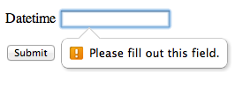
Web Forms
Client-side validation
HTML5 introduce the required annotation
With it, an input can’t be submitted until a value is given
<p>
<label>
Datetime: <input type="datetime" required />
</label>
</p>

Slide 26
Web Forms
Client-side validation
It is also possible to limit the length of the input, using the maxlength attribute
<p>
<label>
Comments: <textarea name="comments" maxlength="160"/>
</label>
</p>

Slide 27
Web Forms
Client-side validation
The pattern attribute allows you to specifies a RegEx that the control’s value has to match
<label>
Course Code: <input type="text" pattern="[1-5][A-Z]{3}"/>
</label>

Slide 28
Web Forms
Client-side validation
The min and max attributes indicate the allowed range of values for the element
<label>
Birthday: <input type="date" min="1900-12-31" />
</label>
<label>
Quantity: <input type="number" min="1" max="20" />
</label>

Slide 29
Web Forms
New input types
New input types are available :
search
tel
url
email
datetime
date
month
week
time
number
range
color
image

Slide 30
Web Forms
New input types
Each one of these new types, bring one or more of the following advantages:
A better semantic (tel, search, …)
User input validation (email, url, number, …)
New controls provided by the browser (range, …)

Slide 31

Web Forms
Search field
The search type is very similar to the text one
The difference is primarily stylistic
<p>
<label>
Search <input type="search" />
</label>
</p>

Slide 32
Web Forms
Telephone field
The tel type represents a control for editing a telephone number
The type doesn’t enforce a particular syntax to support all the format variety around the world
<p>
<label>
Telephone <input type="tel" />
</label>
</p>

Slide 33

Web Forms
Email field
The email type represents a control for editing an email address
<p>
<label>
E-mail <input type="email" />
</label>
</p>

Slide 34

Web Forms
URL field
The url type represents a control for editing a single absolute URL
<p>
<label>
URL <input type="url" />
</label>
</p>

Slide 35

Web Forms
Date field
The date type represents a control for setting the element's value to a specific date
<p>
<label>
Date <input type="date" />
</label>
</p>

Slide 36
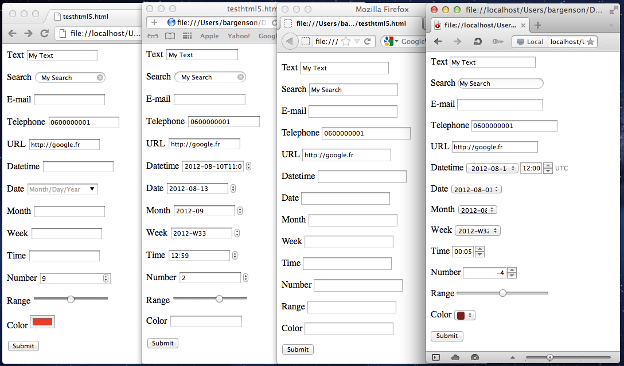




HTML5 markups
Web Forms

Slide 37
Web Forms
Auto-completion
The new list attribute allows you to defined suggestions to the user
The attribute must refer to a datalist id containing the suggestions
You can use Ajax to update the datalist content in function of the user input if you need to

Slide 38
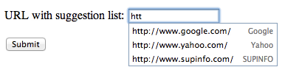
Web Forms
Auto-completion
<label>
URL with suggestion list:
<input type="url" list="hpurls">
</label>
<datalist id="hpurls">
<option value="http://www.google.com/" label="Google">
<option value="http://www.yahoo.com/" label="Yahoo">
<option value="http://www.supinfo.com/" label="SUPINFO">
</datalist>

Slide 39
Questions ?

Slide 40
Media markups
HTML5 - New markups

Slide 41
Media Markups
Audio & Video
There are more and more Audio and Video on the web
Until now, you had to use non standardize technologies like Java Applets or Flash
Need specific plug-in

Slide 42
Media Markups
Audio
The audio new element represents a sound or audio stream
Content may be provided inside the audio element
User agents should show this content to the user only if they don’t support the audio element

Slide 43

Media Markups
Audio
Example :
<audio src="http://images.wikia.com/starwars/images/3/38/UlicFalls.ogg" controls>
Your browser doesn't support the HTML5 audio element.
</audio>

Slide 44
Media Markups
Video
The new video element is used for playing videos and audio files with captions
Again, content may be provided inside the video element
User agents should show this content to the user only if they don’t support the video element

Slide 45

Media Markups
Video
Example :
<video src="myVideo.mp4" poster="movie.jpg" controls>
Your browser doesn't support the HTML5 video element.
</video>

Slide 46
Media Markups
Common attributes
audio and video have some common attributes
preload: to pre-download the media resource
autoplay: to automatically begin playback of the media resource

Slide 47
Media Markups
Common attributes
audio and video have some common attributes
controls: to ask to the user agent to provide its own set of controls
loop: to seek back to the start of the media resource upon reaching the end

Slide 48
Media Markups
Alternative sources
The source element allows to specify multiple alternative of sources to a media element
Allows the browser to choose the better source based on its media type or codec support

Slide 49
Media Markups
Alternative sources
Example:
<audio controls autoplay loop>
<source src="song.ogg" type="audio/ogg" />
<source src="song.mp3" type="audio/mpeg" />
Your browser doesn't support the HTML5 audio element.
</video>

Slide 50
Media Markups
Support for audio codecs
Browser | Version | Codec Support
Internet Explorer | 9.0+ | MP3, AAC
Firefox | 3.6+ | Ogg Vorbis, WAV
Google Chrome | 6.0+ | Ogg Vorbis, MP3, WAV (since Chrome 9)
Apple Safari | 5.0+ | MP3, AAC, WAV
Opera | 10.0+ | Ogg Vorbis, WAV
Android | 2.3+ | MP3, AAC (device dependent)
iOS | 3.0+ | MP3, AAC
Blackberry | 6.0+ | MP3, AAC
Notes:
http://html5doctor.com/html5-audio-the-state-of-play/

Slide 51
Media Markups
Support for video codecs
Browser | Version | Codec Support
Internet Explorer | 9.0+ | MP4
Firefox | 4.0+ | WebM, Ogg
Google Chrome | 6.0+ | MP4, WebM, Ogg
Apple Safari | 5.0+ | MP4
Opera | 10.6+ | WebM, Ogg
Android | 2.3+ | MP4, WebM (since 4.0)
iOS | 3.0+ | MP4
Notes:
http://www.longtailvideo.com/html5/formats/

Slide 52
Questions ?

Slide 53


